Slide 1
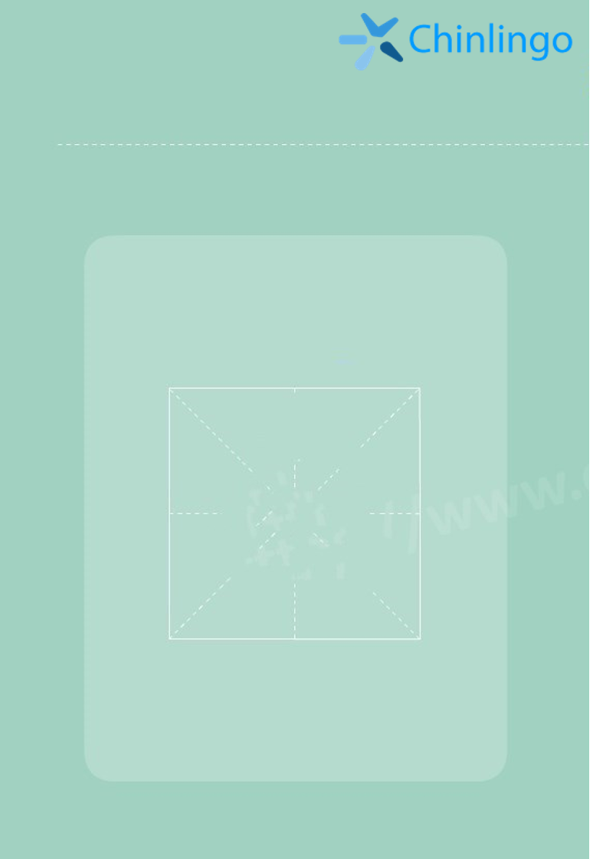
New words
jiā
ài
家
爱
home， family
love

Slide 2
New words
yǒu
jǐ
kǒu
口
有
几
have
how many
mouth, measure word
（for familiy members）

Slide 3
New words
bà ba
mā ma
爸
爸
妈
妈
father， dad
mother, mom

Slide 4
New words
jiě jie
dì di
姐
姐
弟
弟
old sister
little brother

Slide 5
Dialogue
Chinlingo
Day 6——Family menbers
A：小明，你家有几口人？
B：我家有6口人。
A：有谁呢？
B：爸爸妈妈，两个姐姐，一个弟弟和我。我很爱他们。
Xiǎo míng ， nǐ jiā yǒu jǐ kǒu rén ？
Xiaoming, how many people are there in your family?
Wǒ jiā yǒu liù kǒu rén 。
Six.
Yǒu shuí ne ？
Who are they?
Bà ba mā ma ， liǎng gè jiě jie ， yī gè dì di hé wǒ 。 wǒ hěn ài tā men 。
My parents, two old sisters, one little brother and me. I love them so much.

Slide 6
Grammar
Nǐ jiā yǒu jǐ kǒu rén
你家有几口人？
How many family members in your family.
口(kǒu) The number of family members.
个(gè) the same as above.
Numbers
yī èr sān sì wǔ liù qī bā jiǔ shí
一 二 三 四 五 六 七 八 九 十

Slide 7
Expansion
fù qīn
爸爸 Dad. 父亲 Usually used in written language.
mǔ qīn
妈妈 Mom. 母亲 Usually used in written language.
哥哥 (gē ge) older brother
弟弟 (dì di) younger brother
姐姐 (jiě jie) older sister
妹妹 (mèi mei) younger sister
爷爷 (yé ye) grandpa
奶奶 (nǎi nai) grandma

